Slide 1
Software Engineering
Intermediate Report

Slide 2
1. About our Application
2. Scrum
3. SRS
4. Analysis Model
I n d e x

Slide 3
About our application
1

Slide 4
HYUⓔmini
Objective
“Simplicity is the ultimate sophistication.”
Leonardo da Vinci
Notes:
HYUⓔmini Project는 기존의 한양대학교 애플리케이션에서 학생들에게 자주 이용되는 필수적인 기능만을 추출하여 좀 더 사용하기 편하게 리팩토링하여 서비스를 제공하기 위해 시작되었습니다.

Slide 5
HYUⓔmini
Target User
Original
HYUⓔmini
Seoul Campus Professor Academy
Employee
… Too Complex!
ERICA Student ONLY!
Notes:
기존의 한양대학교 애플리케이션은 서울캠퍼스, ERICA캠퍼스의 모든 학부생, 교직원, 사무원, 대학원생이 사용했다면,
저희 애플리케이션은 오로지 ERICA 캠퍼스의 학부생만을 타겟으로하여 더 쉽게, 더 간편하게 필요한 기능에 접근하게끔 만들었습니다.

Slide 6


HYUⓔmini
Target Platform

Slide 7
HYUⓔmini
Stakeholder
Prof. Scott Lee
Manager (School)
Ten Developers
ERICA Students

Slide 8
Scrum
2

Slide 9
Why?
Why are we select Scrum?
Speed up development
Can introduce XP partially.
Notes:
이터레이션 중에 요구사항 변경이 없음.
효율적인 분업
빠른 개발
주기적인 요구사항 리뉴얼

Slide 10
How?
How can we apply Scrum to our project?
Free Member Switching
Apply XP Methodology
Daily Scrum Meeting

Slide 11
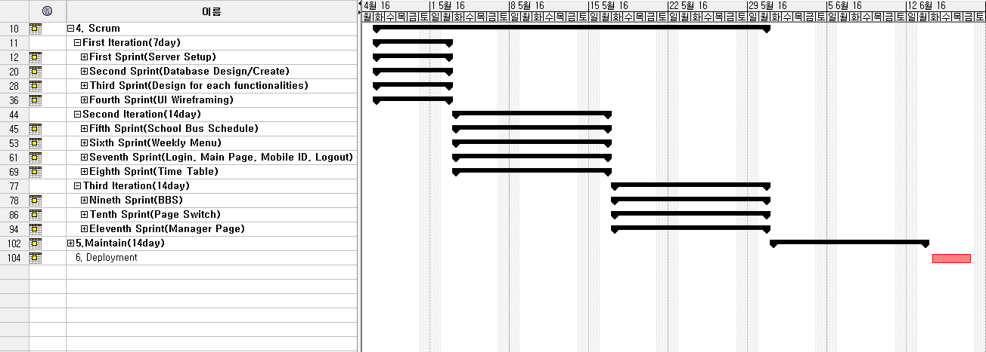
Scrum planning
Gantt Chart

Slide 12
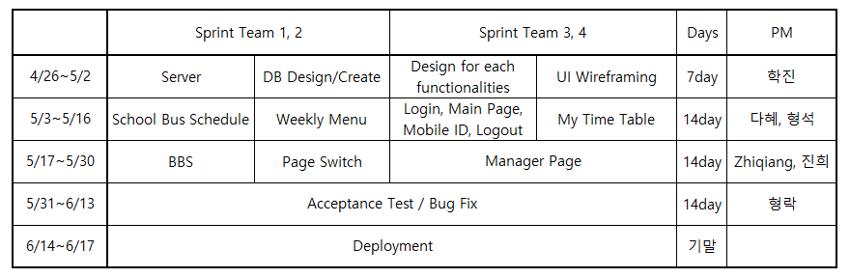
Scrum planning
Four Sprints / Iteration.

Slide 13
SRS
3

Slide 14
SRS Format
Introduction
Purpose
Scope of Project
Glossary
Overview of Document

Slide 15
SRS Format
Overall Description
System Environment
User Characteristics
Use Cases
Use Case 1: Login System
Description
Use Case Diagram
Use Case 2: Main Page
…

Slide 16
SRS Format
Requirements Specification
Use Case1: Login System
Functional Requirement1: …
Functional Requirement2: …
…
Non-functional Requirement5: …
…
Use Case2: Main Page
Functional Requirement1: …
…
…
Non Functional Requirements
non-functional requirements 1
non-functional requirements 2
…

Slide 17
Use Case 2. Main Page
Use Case Diagram

Slide 18
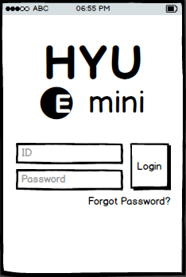
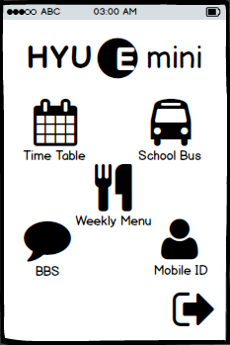

Use Case 2. Main Page
Description(User Scenario)
Login
Succeed
Manager Login
Login Page
Main Page

Slide 19






Use Case 2. Main Page
Requirements
Logout

Slide 20
Use Case 6. Weekly Menu
Use Case Diagram

Slide 21
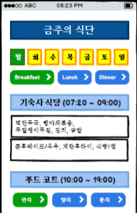
Use Case 6. Weekly Menu
Description(User Scenario)
Button
Pressed

Slide 22
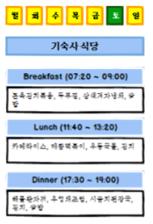
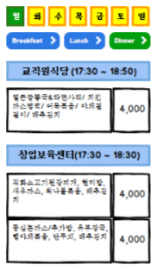
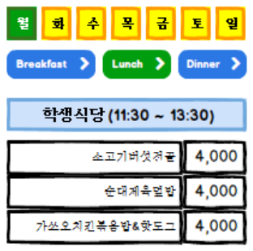
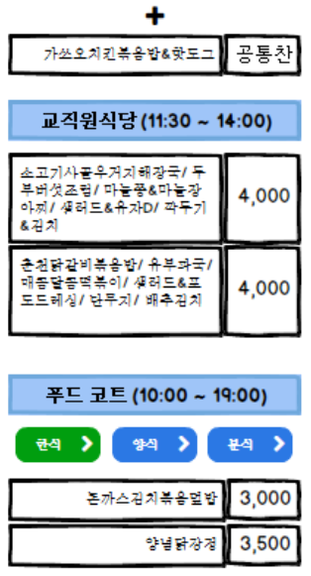
Use Case 6. Weekly Menu
Requirements

Slide 23






Use Case 6. Weekly Menu
Description(User Scenario)
Dragging

Slide 24
Analysis Model
4

Slide 25
Which?
Which diagrams are selected?
Use Case Diagram
Activity Diagram

Slide 26
Why?
Why are we select these diagrams?
Because…
HYUⓔmini is Activity-Oriented Application.

Slide 27
Use Case 2. Main Page

Slide 28
Use Case 6. Weekly Menu

Slide 29
Fin.

